Slide 1

TEAM 9 PROJECT PRESENTATION
TCP IP COMMUNICATION IN ACTION
COMMUNICATION SCENARIO
Opening a secure website
INTERNATIONAL CYBERSECURITY AND DIGITAL FORENSICS ACADEMY, NASARAWA

Slide 2
Problem Statement and Roadmap
How does a user's computer securely communicate with a web server when opening an HTTPS website?
This presentation traces the journey of secure web communication through the five TCP/IP communication layers, showing how protocols, addressing, network devices, encapsulation and security work together from the client to the web server and back.
💻 Client → Application → Transport → Network → Data-Link → Physical → 🌐 Network → Web Server
STEP 1 | STEP 2 | STEP 3 | STEP 4 | STEP 5
Application Layer | Transport Layer | Network Layer | Data-Link Layer | Physical Layer
Dauda Yakuni Haruna | Musa Shuaibu | Risa Koila | Mohammed Ibrahim | Ayodele Banjo
C11/26/FCDF/17183 | C11/26/FCDF/17153 | C11/26/FCDF/17156 | C11/26/FCDF/17175 | C11/26/FCDF/17169
File preparation and application services | Segmentation and reliable delivery | IP addressing and packet routing | Framing and MAC addressing | Transmission of bits/signals
INTERNATIONAL CYBERSECURITY AND DIGITAL FORENSICS ACADEMY, NASARAWA

Slide 3
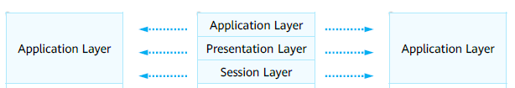
APPLICATION LAYER: Opening a Secure Website
Application Layer
  The application layer provides interfaces for application software so that applications can use network service. The application layer protocols designate transport layer protocols and ports.
  PDUs transmitted at the application layer are called data.
What happens when the user enters an HTTPS URL?
Scenario assumption: HTTPS Client initiate request to the HTTPS Server
IT CONSIST OF PROTOCOL SUCH AS:
HTTPS: Port number: 443 (TCP)
Provides secure web browsing services through encrypted communication.
Telnet: Port number: 23 (TCP)
Provides remote management services.
FTP: Port numbers: 20 and 21 (TCP)
Provides Internet file resource sharing services.
DNS: Port number: 53 (UDP)
Maps domain names to IP addresses.
OSI MAPING
Standard TCP/IP model
OSI model
Equivalent TCP/IP model
INTERNATIONAL CYBERSECURITY AND DIGITAL FORENSICS ACADEMY, NASARAWA

Slide 4
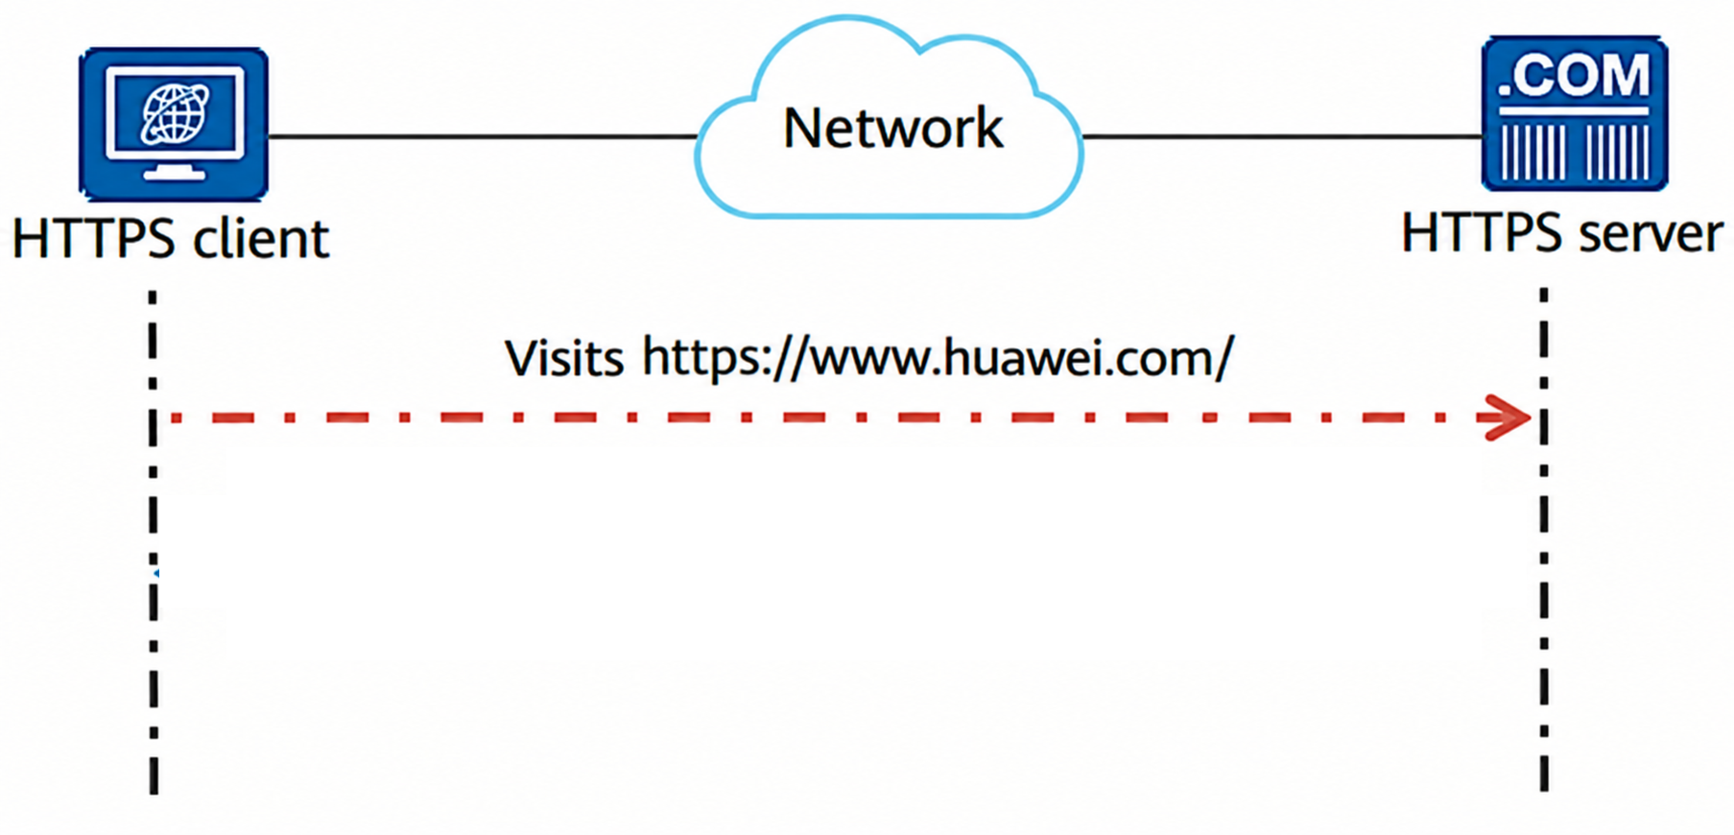
CONTINUE ………..
Common Application Layer Protocol: HTTPS
Hypertext Transfer Protocol Secure (HTTPS) is the secure version of HTTP and is one of the most widely used protocols on the Internet. It is an application-layer communication protocol between a client browser (or other programs) and a web server. HTTPS uses TLS/SSL encryption to protect the confidentiality, integrity, and authenticity of data exchanged between the client and the server.
HTTPS is a typical application of the Client/Server (C/S) architecture.
INTERNATIONAL CYBERSECURITY AND DIGITAL FORENSICS ACADEMY, NASARAWA

Slide 5
TRANSPORT LAYER – TCP Communication
Transport Layer
A transport layer protocol receives data from an application layer protocol, encapsulates the data with the corresponding transport layer protocol header, and helps establish an end-to-end (port-to-port) connection.
PDUs transmitted at the transport layer are called segments.
.
Transmission Control Protocol (TCP)
Characteristics: A connection is established before communication. During transmission, TCP ensures no data loss, no duplication, no errors, and in-order delivery.
Application scenarios: Web browsing, file transfer, email, and other data transmission services demanding high data integrity.
User Datagram Protocol (UDP)
Characteristics: Data packets are directly sent without establishing a connection. UDP does not ensure reliability but has extremely low overhead and latency.
Application scenarios: Video calls, online gaming, DNS queries, and other data transmission services that demand low latency while tolerating a small amount of packet loss.
OSI MAPING
Standard TCP/IP model
OSI model
Equivalent TCP/IP model
INTERNATIONAL CYBERSECURITY AND DIGITAL FORENSICS ACADEMY, NASARAWA

Slide 6
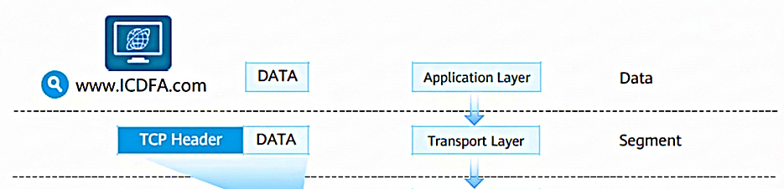
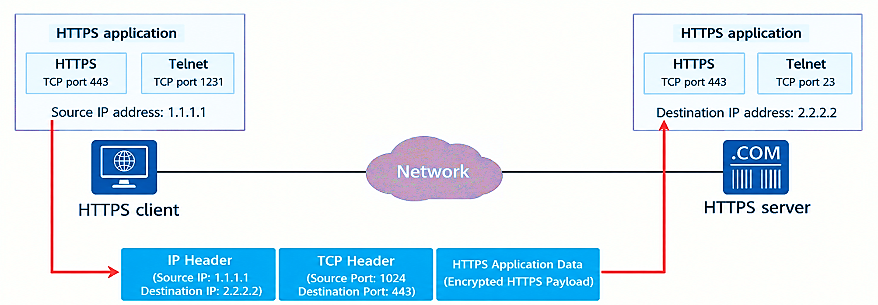
CONTINUE ………..
Data Encapsulation at the Sender
Generally, the source port used by a client is randomly allocated, and the destination port is specified by the application of a server.
The system generally selects a source port number that is greater than 1023 and is not being used.
The destination port number is the listening port of the application (service) enabled on the server. For example, a web server using HTTPS typically listens on port 443.
TCP – Port Number
INTERNATIONAL CYBERSECURITY AND DIGITAL FORENSICS ACADEMY, NASARAWA

Slide 7
Network Layer: IP Addressing
Network Layer
The transport layer is responsible for establishing connections between processes on hosts, and the network layer is responsible for transmitting data from one host to another.
PDUs transmitted at the network layer are called packets.
Functions of the network layer:
Provides logical addresses for network devices.
Routes and forwards data packets.
Common network layer protocols include IPv4, IPv6, ICMP, and IGMP
OSI MAPING
Standard TCP/IP model
OSI model
Equivalent TCP/IP model
INTERNATIONAL CYBERSECURITY AND DIGITAL FORENSICS ACADEMY, NASARAWA

Slide 8
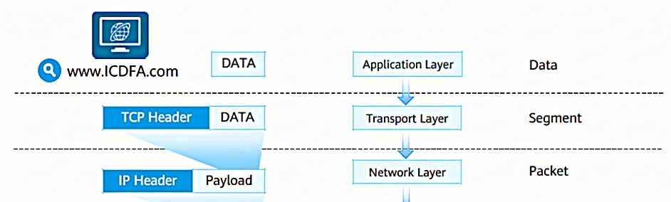
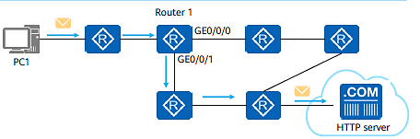
CONTINUE ………..
Data Encapsulation at the Sender
The network layer header of a packet sent by a source device carries the network layer addresses of the source and destination devices.
Each network device (such as a router) that has the routing function maintains a routing table (like a map of the network device).
After receiving a packet, the network device reads the network layer destination address of the packet, searches the routing table for the matching entry of the destination address, and forwards the packet according to the instruction of the matching entry.
Source Ip 192.168.0.2
Destination IP 122.3.3.1
INTERNATIONAL CYBERSECURITY AND DIGITAL FORENSICS ACADEMY, NASARAWA

Slide 9
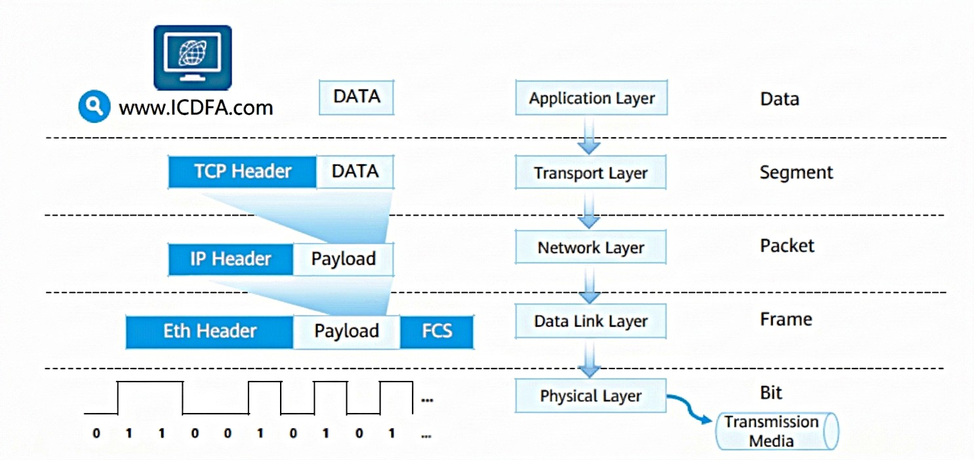

Data-Link Layer: Frames and MAC Address
Data Link Layer
The data link layer is located between the network layer and the physical layer and provides services for protocols such as IP and IPv6 at the network layer. PDUs transmitted at the data link layer are called frames.
Ethernet is the most common data link layer protocol.
Data Encapsulation at the Sender
The data link layer is located between the network layer and the physical layer.
The data link layer provides intra-segment communication for the network layer.
The functions of the data link layer include framing, physical addressing, and error control.
Common data link layer protocols include Ethernet, PPPoE, and PPP.
OSI MAPING
Standard TCP/IP model
OSI model
Equivalent TCP/IP model
INTERNATIONAL CYBERSECURITY AND DIGITAL FORENSICS ACADEMY, NASARAWA

Slide 10
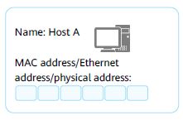
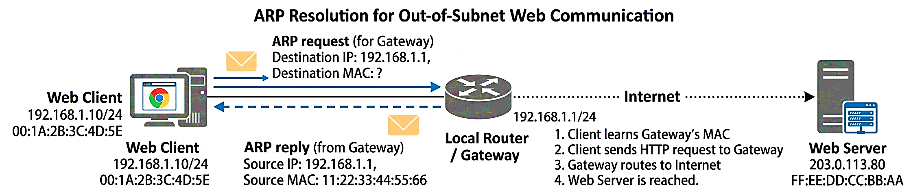
CONTINUE ………..
A Media Access Control (MAC) address uniquely identifies a Network Interface Card (NIC) on a network. Each NIC requires and has a unique MAC address.
MAC addresses are used to locate specific physical devices in an IP network segment.
A device that works at the data link layer, such as an Ethernet switch, maintains a MAC address table to guide data frame forwarding.
A MAC address is recognizable as six groups of two hexadecimal digits, separated by hyphens, colons, or written without a separator.
Example: 48-A4-72-1C-8F-4F
ARP
Address Resolution Protocol (ARP):
  Discovers the MAC address associated with a given IP address.
INTERNATIONAL CYBERSECURITY AND DIGITAL FORENSICS ACADEMY, NASARAWA

Slide 11
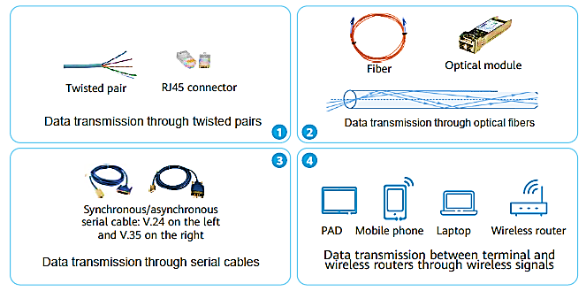
Physical Layer: Bits & Signals
Physical Layer
After data arrives at the physical layer, the physical layer converts a digital signal into an optical signal, an electrical signal, or an electromagnetic wave signal based on the physical media.
PDUs transmitted at the physical layer are called bitstreams.
Data Encapsulation at the Sender
OSI MAPING
Standard TCP/IP model
OSI model
Equivalent TCP/IP model
INTERNATIONAL CYBERSECURITY AND DIGITAL FORENSICS ACADEMY, NASARAWA

Slide 12
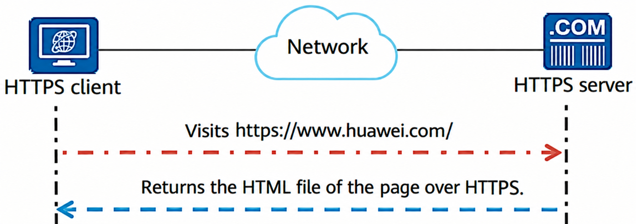
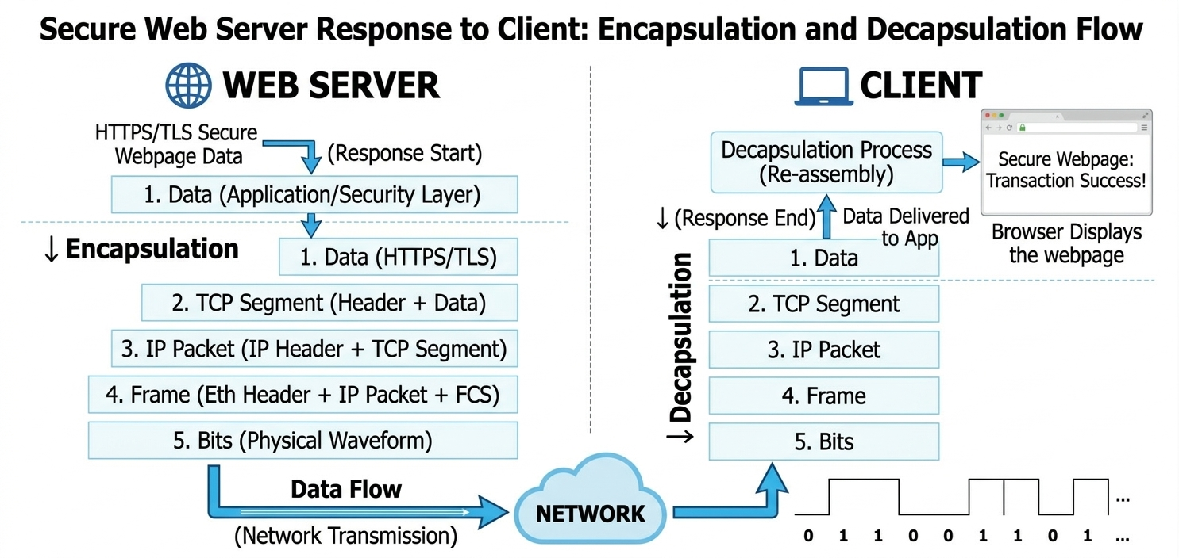
Website Response, Decapsulation & Troubleshooting
TROUBLESHOOTING
Let say the secure website refuse to open.
We can use a layer-by-layer troubleshooting logic:
1. PHYSICAL
Is the client connected to the network?
↓
2. DATA-LINK
Is local network connectivity working?
↓
3. NETWORK
Does the client have valid IP configuration
and reach the destination?
↓
4. TRANSPORT
Can the required service be reached?
↓
5. APPLICATION
Does DNS work correctly?
Does HTTPS/TLS establish successfully?
INTERNATIONAL CYBERSECURITY AND DIGITAL FORENSICS ACADEMY, NASARAWA

Slide 13
References
References
Huawei Technologies Co., Ltd. (2024). HCIA-Datacom V1.0 Course Material. Huawei ICT Academy.
Cisco Networking Academy. (2023). Introduction to Networks (ITN), CCNA Version 7. Cisco Networking Academy.
Internet Engineering Task Force (IETF). RFC 9293: Transmission Control Protocol (TCP). Available at: https://www.rfc-editor.org/rfc/rfc9293
Internet Engineering Task Force (IETF). RFC 9110: HTTP Semantics. Available at: https://www.rfc-editor.org/rfc/rfc9110
IEEE Standards Association. IEEE 802.3 Standard for Ethernet Networks.
INTERNATIONAL CYBERSECURITY AND DIGITAL FORENSICS ACADEMY, NASARAWA

